Slide 1


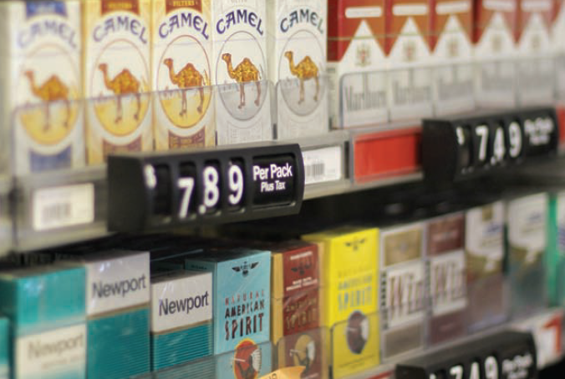

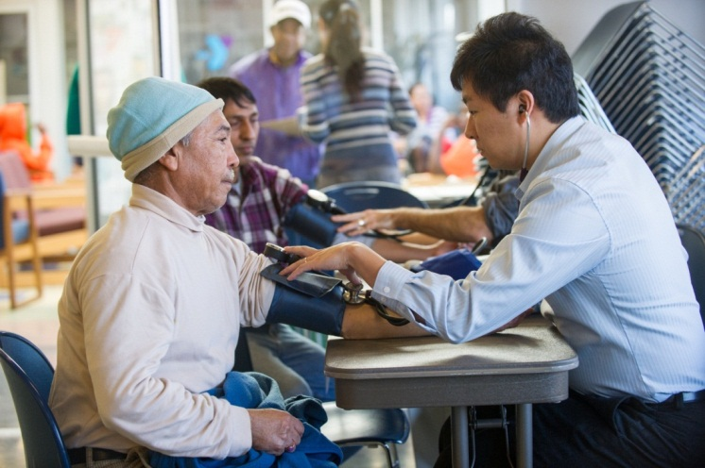
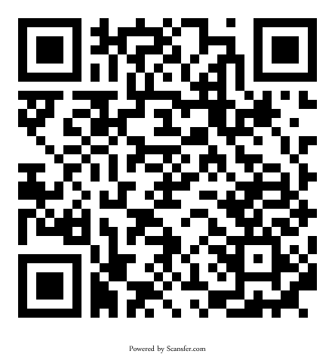
Assessing Attitudes Towards Tobacco Advertising in Winooski, VT
Azevedo K., Brown B., Chang E., Evangelista J., McDaniels I., Kuzina O., Patel A., Nugent K., Wilcke B., Carney J.
University of Vermont College of Medicine, Burlington, VT
Introduction
Results
Discussion
There are approximately 75,500 adult smokers in Vermont, making up about 15% of the state’s adult population¹. These rates are relatively higher in low-income populations. Winooski, Vermont is vulnerable to high tobacco use rates given that 23.6% of Winooski residents live below the poverty line².
The majority of tobacco users begin in their youth³. Tobacco advertising, which has been shown to have a direct, dose-dependent association with tobacco use in youth³, is highly prevalent in stores in Winooski. In conjunction with the Winooski Coalition for a Safe and Peaceful Community (WCSPC), we assessed the attitudes toward tobacco advertising within the Winooski Community.
Youth exposed to tobacco advertising are more likely to smoke or use tobacco products³. The majority of respondents believe that youth smoking and tobacco use in Winooski is a problem and that store owners should decrease or eliminate tobacco advertising. This demonstration of community support for reduced tobacco advertising will be instrumental for achieving the goals of the Small Changes, Big Impact⁴ initiative in Winooski, VT.
⁴
Objectives
Initiate the Small Changes, Big Impact⁴ protocol
Assess attitudes toward tobacco advertising and youth tobacco use in Winooski, VT
Provide the WCSPC data for efforts to reduce tobacco advertising and use
• 18 % of respondents identified themselves as smokers.
• 59% of respondents thought that youth are influenced by tobacco advertising in stores.
Respondents thought that grocery stores (77%), pharmacies (77%), corner stores (54%) and gas station/convenience stores (55%) should not post advertisements and signs for tobacco products.
 | Nonsmokers | Smokers | Overall
Tobacco advertising should not be allowed inside stores | 71% | 29% | 66%
Tobacco advertising should not be allowed outside stores | 85% | 65% | 83%
Store owners should show fewer tobacco advertisements inside stores | 63% | 59% | 62%
Youth smoking & tobacco use is a problem in Winooski | 66% | 29% | 59%
The majority of respondents believe that tobacco products should not be advertised anywhere inside or outside of stores.
Both smokers and non-smokers think store owners should show fewer tobacco advertisements/displays in their stores.
The majority of survey respondents think that grocery stores, pharmacies, corner stores, and gas station/convenience stores should not post advertisements and signs for tobacco products.
Methods
Designed a survey to assess the opinions of adult community members towards tobacco advertising and youth tobacco use in Winooski
Administered the survey in three different settings:
  Sent home with students of the Winooski school district
  In-person at the parent-teacher conference at the Winooski school district
  In-person at the Winooski Community Health Fair
Organized a free health fair at the Winooski Community Health Center
• Respondents thought that grocery stores (66%), pharmacies (73%), corner stores (41%) and gas station/convenience stores (43%) should not sell tobacco products.
• 26% of respondents reported that they or other members of their family received advice from a doctor regarding tobacco products use in the past year.
References
1. 2010 Adult Tobacco Survey. Rep. Vermont Department of Health, Oct. 2011. Web. 22 Sept. 2012. http://healthvermont.gov/research/documents/2010ATSReport_FINAL.pdf
2. State and County Quick Facts. United States Census Bureau. http://quickfacts.census.gov/qfd/states/50/5085150.html. Accessed 12/1/12
3. Berman, M. and Snyder, K. "Cause and Effect: Tobacco Marketing Increases youth Tobacco Use, Findings of the 2012 Surgeon General's Report." The Center for Public Health and Tobacco Policy. May 2012.
4. Vermont Department of Health. "Small Change / Big Impact." http://healthvermont.gov/family/fit/documents/SCBI_Guidebook.pdf. Accessed 12/12/12.
Photo credits: Rajan Chawla
Eric Chang takes a blood pressure measurement at the Winooski Health Fair

