Slide 1
Leading Effective Meetings
Details of Facilitation
APHL Annual Meeting June 3, 2019
Leah D. Gillis M.S., Ph.D., HCLD(ABB)

Slide 2
Why this Training
  Techniques for improving meeting facilitation, organization and communication
  Elements for managing group development, keeping participants motivated and engaged
  Tips on consensus building, managing disruption, and practical application

Slide 3
Leading effective meetings
Purpose: provide training framework for preparing, starting, running and closing masterful meetings
Objectives:
Identify typical problems with meetings
Learn tools for avoiding unnecessary meetings
Develop strategies for preventing and addressing meeting dysfunction
Goal: To enhance participants meetings facilitation skills.

Slide 4
Ground Rules
Respect the speaker(s) and listener(s)
Deeefur Judgemint
Headline 1st & then E.L.M.O.
  (ELMO = Enough, Let’s Move On)
Timeliness
Mindfulness
  (Work on this work, in this meeting)
E-Manners
Manage yourself
  (breaks, e-breaks, be present, etc.)
Consensus

Slide 5

Role of the Facilitator
Guide
Peacemaker
Motivator
Taskmaster
Bridge-builder
Praiser
Clairvoyant
Active Listener
Engager – meaningful engagement every 10 to 15 minutes
Notes:
Guide
Peacemaker
Motivator
Taskmaster
Bridge builder
Praiser
Clairvoyant
Active Listener
Engager – the facilitator assures meaningful engagement every 10 to 15 minutes

Slide 6
Four components of a well-developed meeting:
Preparation
Start
Execution
Close
Preparation
Close
Start
Execution

Slide 7
Preparation
Clear purpose, products, agenda
Advance notification
Right people
Right information

Slide 8
Prepare, Prepare, Prepare
Decide the Purpose
  Why are we holding this meeting?
Define the Products
  What do we want to have when we are done?
Select the Participants
  Who needs to be present to achieve the purpose and create the product?
Identify Probable Issues
  What are the topics that will need to be addressed?
Develop the Process
  What are the steps needed?

Slide 9
Purpose and Product
Purpose answers…
  Why are we doing this? Why is this important?
Product answers…
  What must we have when we are done?
  3 “H”s
    What should we have in our hands (outputs), heads (knowledge), hearts (beliefs)?
Notes:
Create working exercise handout based on table on page 34 but add type of meeting column and instead of improve hiring process have improve proficiency testing process?
Prepare two – let the group pick the scenario.

Slide 10
Participants
Questions to answer:
Who will be affected by the decision?
What level of involvement should they have in the process?
Whose perspectives, involvement and buy in are so critical that they should be at the table or represented by someone who is?

Slide 11
Process for us
1) There have been two consecutive PT failures for parasitology testing in your laboratory. The number of specimens tested per year is very low and may be part of the problem. Your director is insistent on keeping the parasitology testing on the lab’s license. You have been tasked with bringing the testing up to par and passing the next PT.
2) The hepatitis B Ab PT test analyte is trending towards a failure, with one false negative result, followed by 2 false negative results for the next quadrimester. You noted that for this PT sample supplier, the consensus group is very small and all reported the same results as your laboratory reported using the same instrument and that instrument manufacturer’s kit. Your director asked you to determine what is going on and to develop a plan to solve the problem.
3) Your laboratory’s PT supplier is increasing its annual subscription price by 4-fold. Your laboratory director wants you to find another vendor; you think the lab should stay with this vendor, as do the supervisors. How will you resolve the dilemma?
Notes:
The overall concern of each group is PT testing in a public health laboratory and making the best changes/improvements based on three different scenarios that your laboratory director has discussed with you:
What are the steps needed to complete the meeting development process?
5 minutes to discuss and 2 minutes to report.

Slide 12
Process for us
What are the steps needed to complete the meeting development process?
Decide the purpose of your first meeting.
What will be the products?
Who will be the participants?
Do you foresee any probable issues?
Notes:
As part of our facilitation skill building, we are going to divide into three groups and each group will have a different problem to develop and resolve using the Facilitation techniques:
The overall concern of each group is PT testing in a public health laboratory and making the best changes/improvements based on three different scenarios that your laboratory director has discussed with you:
There have been two consecutive PT failures for parasitology testing in your laboratory. The number of specimens tested per year is very low and may be part of the problem. Your director is insistent on keeping the parasitology testing on the lab’s license. You have been tasked with bringing the testing up to par and passing the next PT.
2) The hepatitis B Ab PT test analyte is trending towards a failure, with one false negative result, followed by 2 false negative results for the next quadrimester. You noted that for this PT sample supplier, the consensus group is very small and all reported the same results as your laboratory using the same instrument and that instrument manufacturer’s kit. Your director asked you to determine what is going on and to develop a plan to solve the problem.
3) Your laboratory’s PT supplier is increasing its annual subscription price by 4-fold. Your laboratory director wants you to find another vendor; you think the lab should stay with this vendor, as do the supervisors. How will you resolve the dilemma?

Slide 13
Start
Timely start
Purpose and products reviewed
Key issues identified
Agenda confirmed
Ground rules reviewed

Slide 14
Starting the meeting with energy
INFORM (Purpose & Product)
  Start meetings with: “The purpose of this meeting is… When we are done, we will have…”
EXCITE (Benefits to them)
  Get them excited about the process by giving them a clear vision of the overall result to be achieved and the benefits.
EMPOWER (Their Role)
  Empower them by discussing the important role they play in the process and the authority that has been given to them.
INVOLVE (Their Objectives)
  Get them involved in the process by having them speak as early as possible (e.g., key topics, one minute check in)
Confirm the agenda and ground rules!

Slide 15
The Importance of Engagement
Seek Tools and How to Use Them
Ask Great Starting Questions
Float Ideas if Necessary
List to Gather Details
Brainstorm to Generate Ideas
Group to Categorize
Prioritize to Identify Key Items
Lobby to Gain Buy-In
Notes:
Role play
Plan the tools in advance of the meeting

Slide 16
Ask Great Starting Questions
Great starting questions draw a “vivid image” that prepares the participants to respond.
Have the participant “see” their answers before you go there.
Then ask the question.

Slide 17

Great Starting Questions, continued
Principle 5. Information Gathering
Start by announcing which participant will respond first and the order in which the role call is ordered.
We’ll start by going around the room starting with…
2. Begin with an image-building phrase:
“Think about . . . Imagine . . . If . . . Consider . . .”
Extend the image so the participants can “see” the answers. This usually requires at least two or three phrases
What do you remember? Who was there? How did
you feel?
4. Ask the direct question.
5-6
Notes:
(Type A).
Type A: What do you like to do on vacation?
Type B: Bob, we are going to start with you and follow our roll call list. (Step
Think about the vacations you have been on when you have had the most fun. (Step 2) Think about the things you were doing, the things that you absolutely enjoyed, the things that really thrilled you. (Step 3) Let’s build the list. What do you like to do on vacation? (Step 4)
Break out activity; practice applying type a and type b questions

Slide 18
Exercise on Starting Questions!?!
IEEI
Great starting questions draw a “vivid” image that prepares participants to respond
Notes:
Read page 51 (make it about PT?)
Page 53 as exercise? Page 55?

Slide 19
Other Key parts to your Start
Confirm Agenda
Establish or revisit Ground Rules
Make introductions if needed
  Set time limit
  Write it down, give time if question is asked
Establish Parking Boards
  Issues, Decisions, Actions

Slide 20
Process for us
With 3-4 sentences, share how the first meeting will start…
Reviewing
INFORM (Purpose & Product)
  Start meetings with: “The purpose of this meeting is… When we are done, we will have…”
EXCITE (Benefits to them)
  Get them excited about the process by giving them a clear vision of the overall result to be achieved and the benefits.
EMPOWER (Their Role)
  Empower them by discussing the important role they play in the process and the authority that has been given to them.
INVOLVE (Their Objectives)
Notes:
You have identified your purpose, your participants, your desired products, your possible issues, now open your well planned meeting.
5 minutes, 2 minutes to report.

Slide 21
Recording
Decisions made
Actions to be taken
Outstanding issues
Relevant analysis
Use flipchart or project recorded comments so there is agreement and understanding

Slide 22
Record for clarity and buy in
Write what is said before you respond or ask for input from others
What is said not what you heard
Write so they can read it
Ask them to “headline” it if long response
Notes:
Once an agenda item has been completed, provide brief summary and ask if we can move on.

Slide 23

Tricks & Techniques
Timers
Sticky Notes
Large Wall Sticky Note Pad
Parking Lot
Posting Ground Rules
Round Robin
P.I.N.
Checkpoints

Slide 24
Track time
Have time allotted for each item
Make adjustments –
  If time is slipping ask participants to continue or defer
  CONTINUE: We have hit our time limit. Can we end the discussion or do we need additional time? Okay, let’s give it additional 5 min
  DEFER: At the rate we are going we will not be able to spend time needed for thoughtful discussion. Can we move to next meeting or is there another alternative?

Slide 25
Execution
Thoughtful decision making
Constructive conflict
Positive, energetic participation
Focused discussion
Steady meeting flow

Slide 26

Information gathering
Presentation then questions – participant reports and others ask questions
Listing: gathers lower levels of general topic
  Record responses
  Use round robin approach
Brainstorming: gathers large number of ideas
  More ideas the better, be creative and lofty, good to put a time limit on this to create a sense of urgency
  Use fill in phrases “Give me more” “Who’s Next?” “what else?”
  Always follow with some type of grouping or prioritization activity
Notes:
What are Grouping: To categorize
Prioritize: To identify importance
Lobbying: To gain buy-in
he advantages and disadvantages of round robin?

Slide 27
Information gathering continued
Grouping: To categorize
“The objective of this next process is to take items we have created and group them into categories.”
Ask group to determine which category the idea belongs
See if ideas can be consolidated if repeated
Prioritize: To identify importance
What needs to be worked on or what is most critical for the group?
Ex: Dot exercise and voting.
Lobbying: To gain buy-in
Each person can have one minute to share what is most important and why. Why gives a better understanding of the value. After we will vote again

Slide 28
When doing exercises
PeDeQS
  Purpose of Activity
  Example if appropriate
  Directions
  Exceptions if necessary
  Ask for questions
  Ask your starting question (to get them going)
Notes:
Big view – Preview - Review

Slide 29
Checkpoints
Review - what’s been done
Preview – briefly describe what is to come
Big View – How previewed agenda item fits into overall meeting objectives
Notes:
Use example on Pages 62-63 for PT example for cohort

Slide 30
Building Understanding & Agreements
What does consensus mean?
  Agreement to an action that will work for everyone
  Not a majority vote
  100% of decision makers are at least 80% in favor of proposal, willing to support and implement it

Slide 31

Three steps to reach consensus
Proposal – do something in a certain way
Check for understanding
  Spend 80% of your time here
  Avoids people walking away with different understandings of the agreement
  This is not the place for arguing against the proposal or advocating for another option
Check for agreement

Slide 32

Consensus Building Building
Understand Disagreement
Start with Consensus
Decide If Agreement is Necessary
Let Participants Seek Agreement
Take Control As Necessary
7-1
Notes:
What is definition of?
Strategies to close gaps? What else?
Who has a proposal?

Slide 33
Consensus Building, continued
Delineate Alternatives
Identify Strengths and Weaknesses
Merge Alternatives
Use Ranking Techniques
Converge on a Solution
A Decision Process
If All Else Fails, Move On
7-1
Notes:
What is definition of?
Strategies to close gaps? What else?
Who has a proposal?

Slide 34
Checking for Final Agreement
ASK “is there anyone in the group that cannot support or help implement the proposal?”
  This is the time a person can push back on proposal and give reasons for not supporting
  One or more of you may not consider this proposal to be your first choice, but are you at least 80% in favor of it and willing to make it work?
Notes:
e

Slide 35
Um…NO
Listen to what opposition has to say by reflecting back
  Acknowledges their point
  Can be all they need is understanding of their perspective
Ask - What will it take to get you to 80%
  Is there something that can be tweaked that all can agree on the proposed change

Slide 36
Yeah, still no…
Try a Both/And approach if objection is significant
  If another proposal is being made, check for understanding
  Ask how the two proposals might be linked together
  Helps reach strategy on what action to take
Notes:
Remember sometimes best solutions evolve from constructive conflict and it is the facilitator’s role to have group obtain best ideas….
Embrace it and work it!

Slide 37
Fallback options
More consensus – more meetings or special meeting
Leader makes the decision for the group
Voting – least desirable as it leaves ‘winners’ and ‘losers’
Several small agreements – building agreements to get to final agreements to show progress and barriers

Slide 38
Getting to agreements
Delineation
  We seem to agree on…
  Where we seem to disagree…
  Delineate the alternatives
  Group should then have an understanding of how it would work, how long it would take, who and what is involved

Slide 39
Getting to agreements
Strengths, Weaknesses
  group should focus on one alternative and list the strengths
  Then move to strengths of next alternative
  Once all strengths are identified, get weaknesses for each alternative
Merge
  Create new alternative which incorporates strengths of each alternative

Slide 40
Process for us
Consensus
Group 1: Consensus reached, parasitology testing is staying on license. Next steps?
Group 2: After much information gathering, delineating new plan to add another PT supplier. Next steps?
Group 3: No agreement reached. Next steps?
Notes:
For number three, how much time is available before a needed decision?

Slide 41

If There is a Disagreement..
Why People Disagree
  Haven’t heard one another
  Different values
  Past history
When to Jump In
  Taking too much time
  Discussion loses focus
  Only two or three are involved
  Discussion is becoming emotionally charged
Consensus Strategies
  Delineation
  Strengths & Weaknesses
  Merging Alternatives
  Converging Solution

Slide 42
What is Dysfunction
Dysfunctional behavior is any activity by a participant that is consciously or unconsciously a substitution for expressing displeasure with the meeting content, the meeting process or an outside factor.

Slide 43
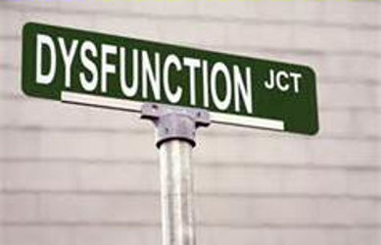
Participant Engagement
Understand Dysfunctional Behavior
Separate Symptom from Root Cause
Focus on Prevention
Detect Non-Verbal Cues
Address Dysfunction Effectively
Inform the Group When Appropriate
Reward Functional Behavior
Respond Appropriately When Challenged
Notes:
What are some examples of dis-engagement? How do you address?

Slide 44
Dysfunction –Prevention Strategies
Detection Strategies
  Actively look for signs of dysfunction – during the prep work and during the meeting
Resolution Strategies
  Approach privately or in general
  Empathize with the symptom
  Address the root cause
  Get agreement on the solution
Notes:
Issues that may come up during prep work – participants who don’t want to hold a meeting or participants who believe they have something to lose or participants not on good terms with others at the meeting or participants that point out the problems than create or work towards solutions
Based on issues identified in preparation, consider:
Assigning seats
Adding ground rules
Making sure you interact with particular people
Paying close attention to particular reactions
Holding informal meetings during breaks

Slide 45
Address Dysfunction
Failure to discuss an issue may negatively influence work of the group
Bringing up the issue typically removes dysfunction but do periodic checks (breaks are a good time to do this)
Avoid:
  Correctly person publicly
  Getting emotional yourself
  Losing objectivity
Notes:
Handout page 99-100

Slide 46
Confirm resolution
Do periodic dysfunction check with participant that raised the issue
Deal with dysfunctional behavior as soon as timing is convenient (often breaks)
Dysfunctional behavior can be contagious and others see ground rules being broken and you as meeting leader not doing anything about it
Announce to the group the resolution
When participants brings up issues, don’t allow them to simmer

Slide 47
Close
Decisions reviewed
Timely finish
Summary provided
Follow up on actions

Slide 48
Closing
Review agenda items covered.
Confirm decisions.
Address issues that are still outstanding.
Assign actions to names and dates.
Evaluate the meeting.
Thank participants and end the meeting.
Document and distribute meeting notes.
Follow up to hold people accountable to assigned actions.
Notes:
Think back to your group, and the resolution…think about how you would lead the closing of that meeting.
Do you think that there are assignments for all three groups?
Which group would have a follow up meeting? Which group would have most assignments?
Why is it important to evaluate the meeting? Asking questions like what went well, what can we improve?
Round robin: each attendee rates meeting, identifies the met objectives…all, one, two. Mentions what went well and what is an area that can be improved.
Did we have the right attendees? Were good decisions made? Is the organization better due to this meeting? How?

Slide 49
Virtual Meeting
Same strategies apply
Preparation
Start
Execution
Close

Slide 50
Meeting Platform Options
What options are available for hosting a meeting?
ZOOM
Go To Meetings
Live Meeting
Skype
Others?
Notes:
Polling, white boards, video, screen sharing,
Applications: Zoom, go to meeting, Share point, breakouts, teleconference

Slide 51
A Note on Participant Topics
With each topic or objective, ask a participant, using the roll call list, “Was this key topic fulfilled?” Place a check indicating that the key topic was addressed.
Once all the key topics have been reviewed, go back to each topic not addressed during the virtual session and determine what should be done as a follow-up action. Be certain to place the follow-up action on the action list.
9-3

Slide 52
Get People Involved and Moving
Stand periodically when leading even virtual sessions. By standing, our energy naturally increases and improves the energy associated with the virtual session.
Use the roll call list frequently and track contribution while conducting round robins and mini round robins.
Vary engagement activities for increased interest.
Praise participant contributions throughout the virtual session.
8-5
Notes:
Video clips, volunteerism, humor, personal experiences. Tell us about a time when…
Good for any meeting, especially lengthy…remember 20 minute rules

Slide 53
Review: the well developed meeting
Preparation
Execution
Clear purpose, products, agenda
Advance notification
Right people
Right information
Timely start
Purpose and products reviewed
Key issues identified
Agenda confirmed
Ground rules reviewed
Thoughtful decision making
Constructive conflict
Positive, energetic participation
Focused discussion
Steady meeting flow
Decisions reviewed
Timely finish
Summary provided
Follow up on actions
Start
Close
Leadership Strategies –the Facilitation Company
  http://www.leadstrat.com/

Slide 54
And details of facilitation
Group dynamics expertise with attention to methods and process plus the need to support everyone to do their best thinking.
A facilitator exhibits extreme focus on Discussion progression to lead the discussion and help participants learn from their own experiences and shared information.
A Facilitator holds the group together and fosters group ownership.
Facilitator Knowledge needed –

Slide 55
And details of facilitation
Facilitator Knowledge needed –
From this process of team building and shared intelligence comes the best solutions and most sustainable agreements,
For enhanced projects that add value to organizations. ….paraphrased from thetrainingclinic.com

Slide 56
Questions???
Notes:
Were objectives met?
What did you like best?
What would you change?

Slide 57
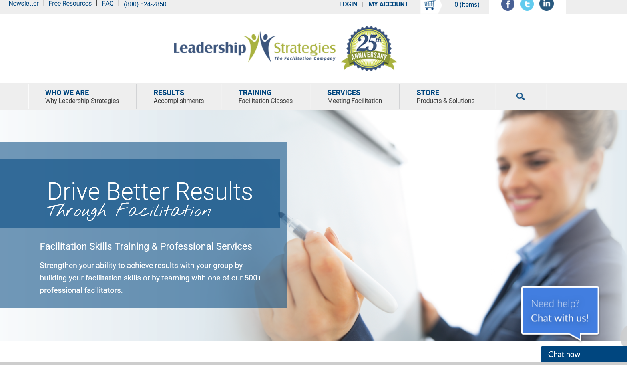
References
Leadership Strategies –the Facilitation Company
  http://www.leadstrat.com/
thetrainingclinic.com

