Slide 1
Internal Safety Training at
Southern Nevada
Public Health Laboratory (SNPHL)
Patricia A. Armour, MT(ASCP)
Laboratory Manager
July 18, 2011

Slide 2

SNPHL background
Located in Las Vegas, Nevada
Created and established in 2003 as a branch laboratory of the Nevada State Public Health Laboratory
Registered with the CDC as a Laboratory Response Network Laboratory in 2004
Owned by the Southern Nevada Health District (SNHD) which is the health authority for Clark County where 70% of the state’s population resides
Perform approximately 50,000 analyses per year

Slide 3

SNPHL staff wear many hats
1 lab manager (LIMS administrator, Safety Officer, Alternate Responsible Official)
3 supervisors (Quality Assurance, microbiology, molecular, immunology, or LRN testing, training, outreach)
5 clinical laboratory scientists (microbiology, molecular, or LRN testing, training, outreach)
2 laboratory technologists (immunology testing)
2 laboratory assistants (shipping)
2 courier/receiving staff
1 clerical staff

Slide 4
Mandatory Safety Training requirements used to design SNPHL plan
Federal regulations (OSHA, EPA, DOT, CDC)
Accrediting organizations (CAP, JCAHO, CLIA)
International standards (ISO 15190, IATA)
State and local laws

Slide 5
Public Health Emergency Preparedness (PHEP) grant capabilities (LRN labs)
Capability 12: Public Health Laboratory Testing
Function 2: Perform Sample Management
Skills and Training
Document training on practices for personnel safety while managing samples; packaging and shipping
Maintain valid Select Agent Registration
Function 3: Conduct testing and analysis
Skills and Training
Document safety training with formal demonstration

Slide 6
Select Agent Program http://www.selectagents.gov/
Inspection list for training requirements
  7CFR 331; 9 CFR 121; 42 CFR 73
“An individual or entity required to register under this part must provide information and training on biosafety and security to each individual with access approval from the HHS Secretary or APHIS Administrator before he/she has such access.”
“Refresher training must be provided annually”

Slide 7
Biosafety in Microbiological and Biomedical Laboratories (BMBL) 5th edition
Code of practice for biosafety
  Key principles containment and risk assessment
Occurrence of Laboratory Acquired Infections (LAIs)
Risk criteria for ascending levels of containment
Agent summary statements
Biosecurity
http://www.cdc.gov/biosafety/

Slide 8
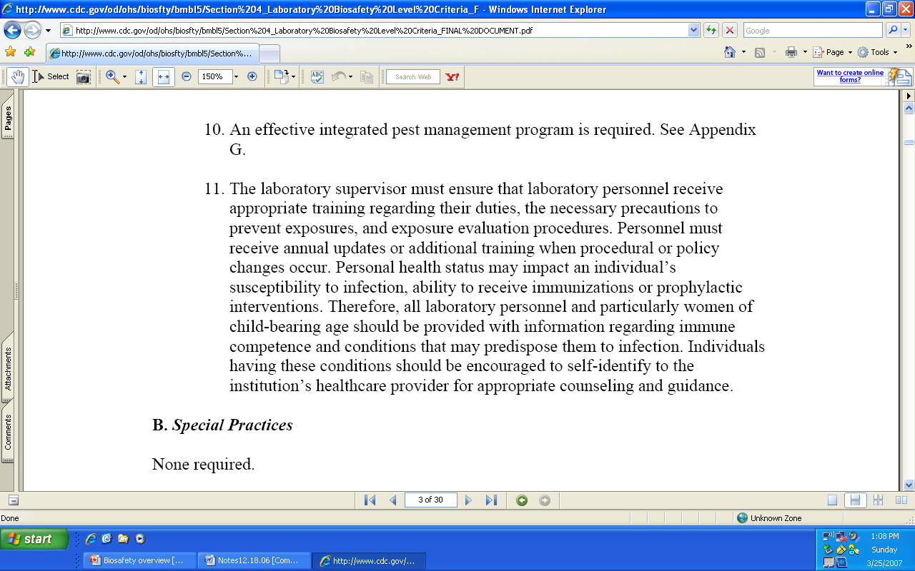
BMBL 5th edition training comment
Section IV Laboratory BSL-3 criteria

Slide 9
Create Culture of Safety at SNPHL
Establish continuous process of hazard recognition, risk assessment, and hazard mitigation
Ensure laboratorian competency to reduce the risk of exposures, laboratory acquired infections, and unintended release of clinical materials to the environment
Ensure all staff understand regulatory requirements

Slide 10
SNPHL mandatory safety training
Topic | Staff trained | When/How often
General lab safety | All lab staff | Upon employment and when revised
Fire extinguisher, Fire prevention, evacuation drill | All lab staff | Upon employment and annual
Chemical safety | All lab staff | Upon employment and annual
Biosafety and PPE | All lab staff | Upon employment and annual
Bloodborne Pathogens | All lab staff | Upon employment and annual
Waste management | All lab staff | Upon employment and annual
N-95 respirator/PAPR | All lab staff | Upon employment and annual
Security | All lab staff | Upon employment and annual
Shipping and Handling | All lab staff | Upon employment and biannual
BSL-3 practices | SRA approved | Upon SRA approval and annual
Select Agent | SRA approved | Upon SRA approval and annual
Notes:
SRA = Security Risk Assessment

Slide 11
SNPHL Internal Training Design
Annual mandatory training schedule
Variety of formats
  Classroom based
  Video
  Computer or Web-based
Measuring effectiveness
  Written test
  Skill demonstration
Documentation

Slide 12
Online Resources
College of American Pathologists Competency http://www.cap.org
Wisconsin State Laboratory of Hygiene Training and Competency http://www.slh.wisc.edu/pt/ptplus/train/index.dot
Iowa Department of Public Health – Prepare Iowa
http://www.idph.state.ia.us/adper/common/pdf/prepare_iowa_overview.pdf
National Laboratory Training Network http://www.aphl.org/member/training/Pages/nltn.aspx
Notes:
CAP – competency modules – purchased – tracking – customizable. All lab departments including safety, QA
WSLH – proficiency testing – competency/training modules – tracking – customizable Competency and Training modules through Medical Training solutions. All lab departments including safety, QA
Prepare Iowa – free training – Lab Biosafety Avoiding Lab Acquired Infections; The role of Sentinel labs in Emergency Response; Introduction to the Public Health Laboratory System; Electronic BT workshop for Sentinel Labs
NLTN – shipping infectious substances; biosafety/biosecurity; podcasts

Slide 13
Additional Resources
Eagleson Institute – Biological Safety Cabinet and Fume hood http://www.eagleson.org/
Safety Lady http://www.safetylady.com/
OSHA – respiratory protection training videos http://www.osha.gov/SLTC/respiratoryprotection/index.html#trainingvideos
CDC – Guidelines for Biosafety Laboratory Competency
http://www.cdc.gov/mmwr/preview/mmwrhtml/su6002a1.htm

Slide 14
SNPHL strategy for providing training with limited resources
Utilize computer or web-based training and competency programs – provides tracking for documentation and background information
Provide site specific training after completion of computer or web-based programs– includes opportunity for open discussion
Perform hands on demonstration of skills using site specific materials

Slide 15
SNPHL strategy for providing training with limited resources
Make the safety program simple
Make it easy for employees to get help, access information and take training
Make written policies, fact sheets, and forms web or intranet accessible.
Utilize visual aids (posters, labels, etc.) in addition to written instructions

Slide 16
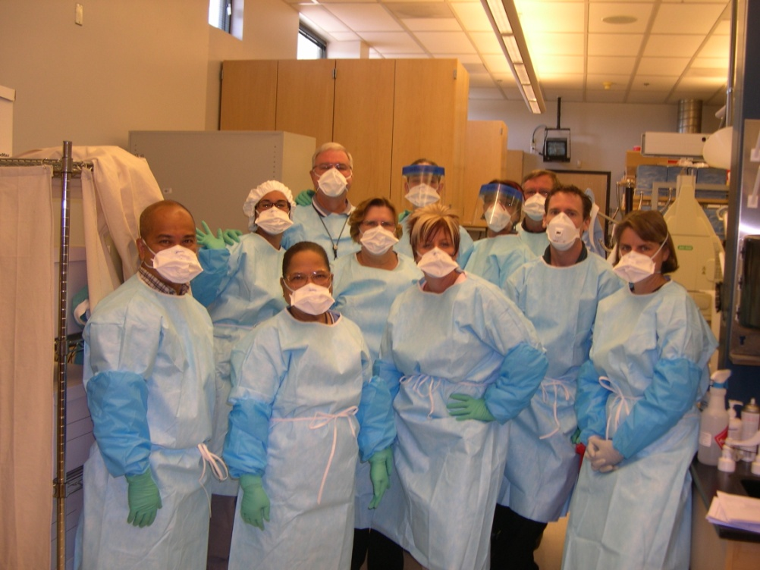
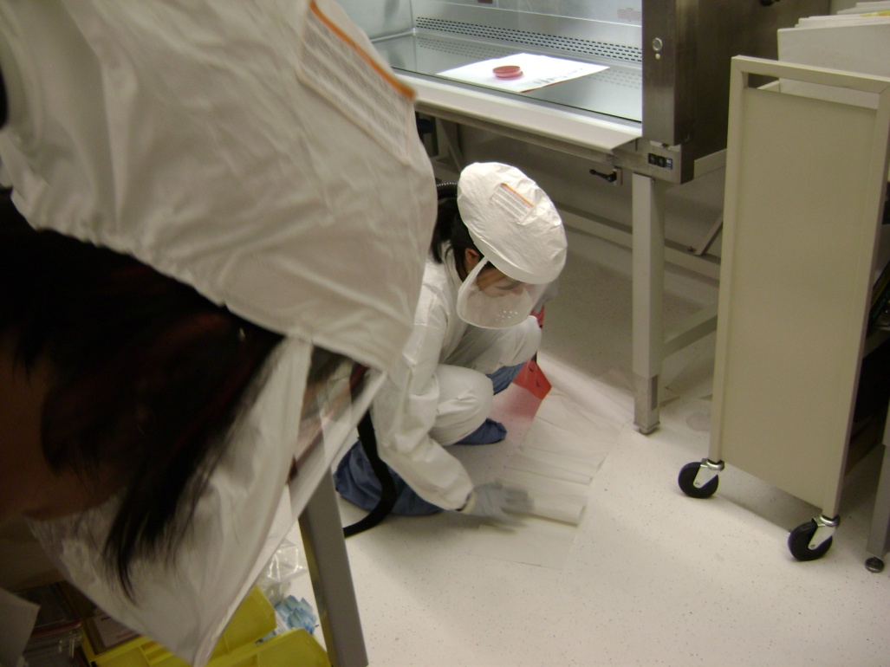
SNPHL annual Biosafety training

Slide 17
Contact information
Patricia Armour, MT(ASCP)
Southern Nevada Public Health Laboratory Manager
Las Vegas, Nevada
Phone: 702-759-1020
Email: armour@snhdmail.org

