Slide 1

The New Jersey Experience:
Training and Assessment for LRN Preparedness
Susan Mikorski, M.Ed., MT(ASCP)SM
Division of Public Health, Environmental and Agricultural Laboratories

Slide 2
New Jersey PHEAL Roles
BT Coordinator – Nelson Delgado
CT Coordinator – Floyd Genicola
Safety Officer – Frank Gordon
State Training Coordinator – me!

Slide 3
BT Coordinator
1) BioThreat Response laboratorians as well as other security risk assessed (SRA+) personnel are trained in the security, biosafety, and incident response plans at least once per year. This training is combined with drills and exercises designed to comply with the Select Agent Regulation, 42 CFR Part 73.
2) Training concerning the safe use of biological safety cabinets is provided to all public health laboratorians.
3) Training on biosafety level-3 (BSL-3) containment practices is provided to every laboratorian and visitor requesting access to the BSL-3 laboratory. This training is provided to local first responders (e.g., Fire Department personnel), and military personnel (e.g., NJ's 21st CST, Air Force, and National Guard personnel).

Slide 4
CT Coordinator
The format has been on-site training for two analysts per state for 2-5 days in Atlanta, GA., that was both lecture and laboratory analytical experiments.
Later computer-based training, CBT, was instituted as an option due to travel restrictions. With the CBT at the state laboratory, the course mirrored the on-site course and later an examination but without the daily analytical performance that can be done up to two months later.
A more rigorous and interactive conference call in the morning and laboratory analysis each afternoon at the state public health laboratory. Data is submitted each day through out the 3 day course.

Slide 5
CT Coordinator
Training is reinforced during validation of the QC materials where each of the four analysts performs five (5) materials at lower and higher concentrations nominal values in clinical matrices. Staff receive computer-based critiques and graphs on their analytical data including precision and accuracy
Training is further reinforced in performance tests (PTs) against the SPHL peers.

Slide 6
Safety Training - Inhouse
Training Session | Time
New Employee Orientation | 75 minutes
Initial Biosafety -bloodborne pathogens (for new employees) | 75 minutes
Annual Biosafety-bloodborne Pathogens (review) | 60 minutes
Initial Chemical Safety Right-to-Know for new employees | 75 minutes
Biennial Chemical Safety Right-to-Know (review) | 60 minutes
Fire Safety/Emergency Evacuation | 60 minutes
Annual Respirator and Fit Testing | 45 minutes
Radiation Safety – Initial and Annual | 60 minutes

Slide 7
Sentinel Lab Training - Regional
 | ‘03 | ‘04 | ‘05 | ‘06 | ‘07 | ‘08 | ‘09 | ‘10 | ‘11
PACK AND SHIP - initial | X | X | X | X | X | X | X | X | X-P
PACK AND SHIP – Recurrent |  |  |  |  | X | X | X | X | X-P
BIOSAFETY/BIOSECURITY |  |  |  | X |  | X |  | X | X-P
ANTIMICROBIAL TOPICS |  | X | X | X | X |  |  |  | X
CHEMICAL TERRORISM |  |  | X |  | X | X
EMERGING PATHOGENS |  |  |  |  | X
FLU |  |  |  |  |  |  | X
BTA – WET WORKSHOPS |  |  | X | X

Slide 8
About 500 people at any given time certified by us to pack and ship in New Jersey (includes sentinel and public health laboratorians)
Average of 80-100 participants for other workshops/conferences
Average of 30 participants for each pack and ship workshop (registration limited)

Slide 9
Sentinel Exercises
Coordinate with the NJDHSS Exercise Support Team
HSEEP Compliant
ASPR funded
Objectives test hospitals

Slide 10
Sentinel Exercises
2006
2007
2008
2009
2010
2011
Project SCOPE – tabletop followed by FS
Operation ESCAPE – 5 regional TTs
Project ComPaSS – one full scale
Operation SwiftBox – five full scales
H1N1 Real Event – real event with AAR
Project Designer Genes - tabletop
CT Tabletop Planned for September

Slide 11
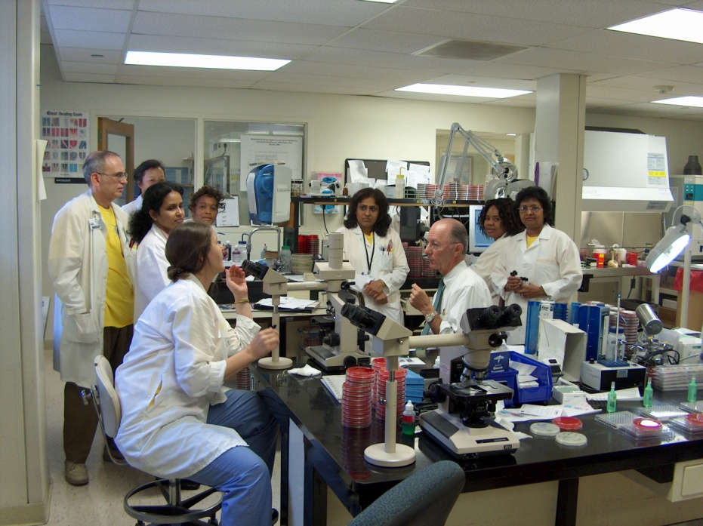
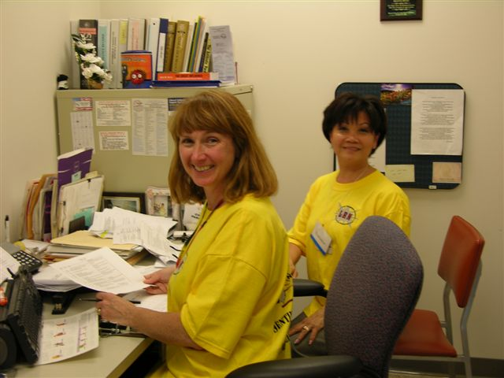
Project SCOPE (Sentinel Communications and Operational Preparedness Exercise): 2006
5 day fullscale exercise, 5 hospitals
Tested whole process: Collect-Detect-Report-Refer (safety and security)
Yersinia pseudotuberculosis
Evaluators from other hospitals
Command center at the state office – MESL developed over the phone

Slide 12
Project SCOPE (Sentinel Communications and Operational Preparedness Exercise)
Areas for Improvement Identified:
Communication within hospital and between hospital and state agencies
Clarification on use of Chain of Custody document
Identification of public officials responsible for transportation of ‘suspect’ samples during an outbreak
Simplification of packaging and shipping process for referral of samples
Simplification of the state CDRSS data entry process
Incorporation of more laboratories in preparedness planning and exercises

Slide 13

Operation ESCAPE (Escherichia coli Assessment and Preparedness Exercise) - 2007
5 Regional Tabletops
30 hospitals played, 24 observed/evaluated
Commercial labs: Quest, ARUP, Mayo
Vendors: Remel, bioMerieux, ThermoFisher, Meridian Bioscience, DC Express, DadeBehring Microscan, BD Diagnostics, Cardinal Health, Trek Diagnostics
Large scale foodborne outbreak
Surge capacity –internal to hospital
Surge capacity - external

Slide 14
Operation ESCAPE (Escherichia coli Assessment and Preparedness Exercise)
Areas for Improvement:
Staffing is a problem – limited hospital microbiologists
Remove microbiologists from tasks of reporting and packaging
Use of volunteers discussed – liability?
Vendors, suppliers, distributors indicated problem with emergency distribution on weekends – limited in scale up production and media QA, distribution not a problem
Commercial labs would help – but without a contract, preference given to regular customers
Equipment and bench space an issue; incubators, refrigerators, blood culture instruments – surge planning needed
MOUs with area laboratories

Slide 15
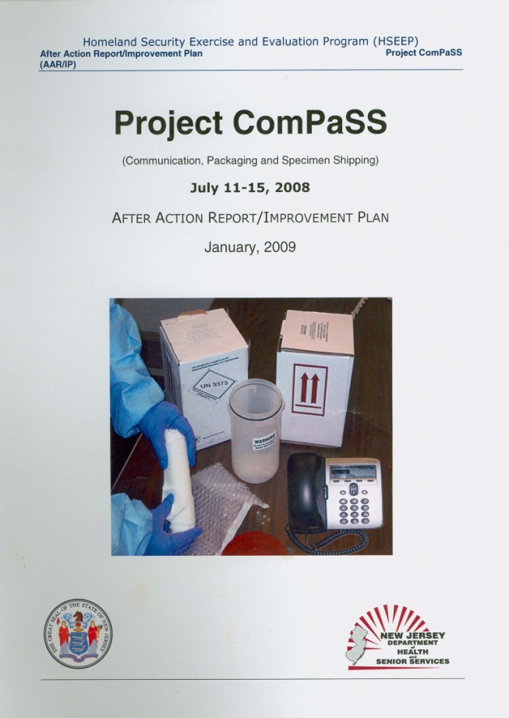
Project ComPaSS: Communication, Packaging and Specimen Shipping - 2008
83 clinical labs participated
Category B shipping exercise
USDOT special permit required to ship a noninfectious substance as an infectious substance (NYDOH)
teleconference beforehand regarding permit
Friday – Monday
F. tularensis in a patient sample
24 hour TAT required
Message sent through LINCS to ICP, CEO and EPC
Each lab rec’d an individual report as well as AAR

Slide 16
Project ComPaSS: Communication, Packaging and Specimen Shipping - 2008
Areas for Improvement:
Communication between LINCS (Local Information Network and Communication System) and hospitals
(58% of ICPs indicated receipt of message within 24 hours; 76% of ICP,EPC or CEO within 24 hours)
Internal hospital messaging –message not passed on promptly resulted in only 32% packages received in 24 h
Most packages safely packaged, but variety of problems with labelling, marking and documentation - 64% had one or more deficiencies

Slide 17
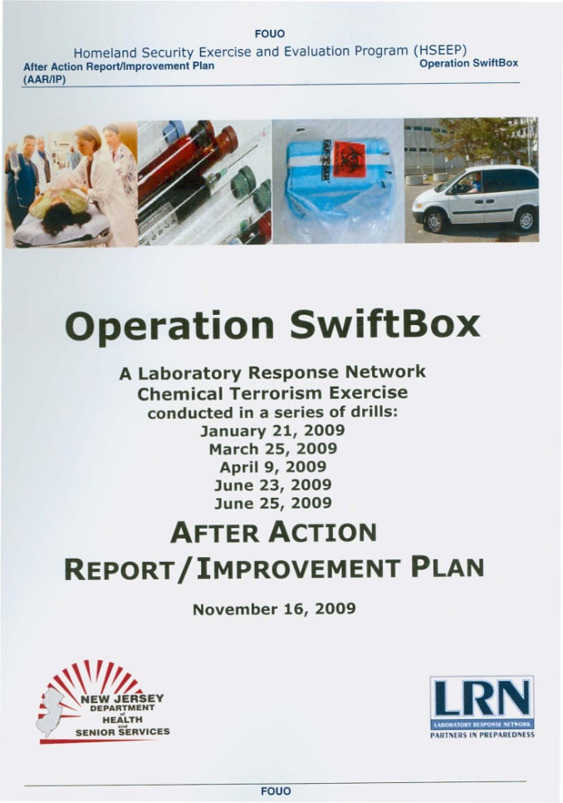
Operation SwiftBox: An LRN-C Chemical Terrorism Packaging Exercise - 2009
72 hospital labs – must have a clinical lab and an ED
Extensive prep for this exercise:
  14 workshops; all 72 labs participated
  Packaging materials purchased and mailed to all labs as a “kit”
  Teleconference on USDOT special permit
  Database update
  Preparation of “fake” samples prior to the exercise
  Pilot test with one local lab

Slide 18
Operation SwiftBox: An LRN-C Chemical Terrorism Packaging Exercise – 2009
Areas for Improvement:
Temperature conditioning of samples
Availability of pelletized dry ice
Availability of couriers
More instruction on following manufacturer’s instructions for packaging (TCP Reliable Qualified Shipper – 72 hour temperature maintenance)
Submission and accessioning forms needed at ECLS – public health laboratory

Slide 19
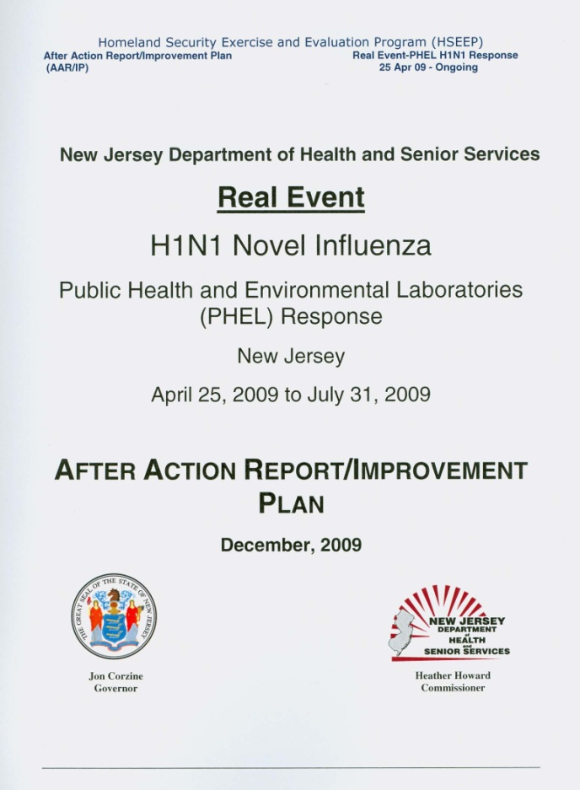
H1N1 Real Event – 2009-2010
Planning underway for a PHEL flu exercise
Used objectives that were developed by planning team
Collected data on events in PHEL as they unfolded
Wrote PHEL AAR
Hosted AAR conference – PHEL, Epi, Commissioner and hospitals presented

Slide 20
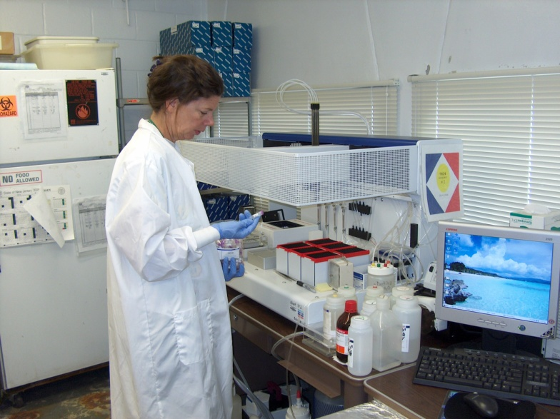
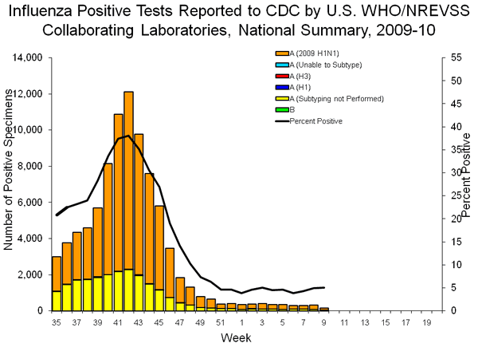
H1N1 Real Event – 2009-2010
Commissioner’s weekly teleconferences, daily webpage updates
PHEL communication with sentinel labs re CDC and ASM testing recommendations
Epi - state and local - screened samples before sending to PHEL
4/26-7/31 screened 2,131 samples – 982 positive for H1N1 novel flu
Communication between PHEL and Epi was good
Instrument breakdown – no backup – no maintenance contract
Weekend scheduling required
Cross-training required
Hospitals varied widely on testing

Slide 21

Project Designer Genes: 2011
5 hospitals played – teams of ICP, Microbiology, ED, Emergency Preparedness and Occupational Health
35 hospitals evaluated/observed
Based on a genetically modified MRSA – resistant to all drugs except daptomycin, encapsulated and increased toxicity

Slide 22
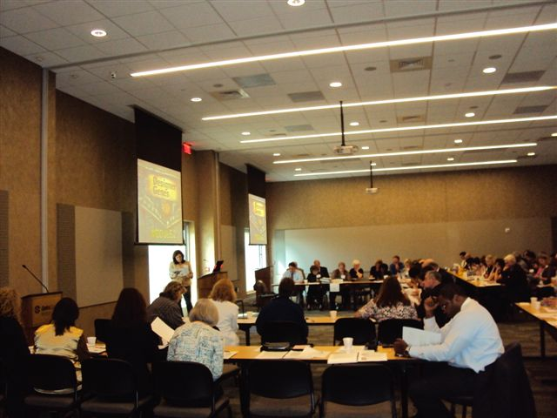
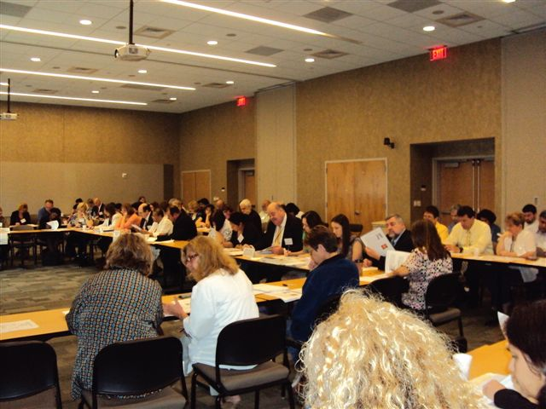
Project Designer Genes: 2011

Slide 23
Lab Exercises: Tips for a Planner
Make sure every planning team member understands HSEEP concepts and terminology – recommend ICS 120
Define clear, precise objectives and not too many
Use SMEs to help write your scenario
  Serve on the planning team
  Serve as consultants as the scenario develops
  Use references
Make sure your scenario is:
  Plausible
  Interesting – include pictures, start with index cases
  Accurate – use expertise of SMEs
  Tells a story

Slide 24
Lab Exercises: Tips for a Planner
“Play out” the scenario with your planning team to determine probably responses and extend the discussion
Background information
  Set the stage with a presentation putting players, observers and evaluators “on the same page”
  Your audience may be diverse
Involve the planning team/SMEs in presenting the scenario and facilitating discussion

Slide 25
Lab Exercises: Tips for a Planner
Give credit to everyone involved – if hospitals are on the planning team make sure you acknowledge their valuable time
Work with hospitals to help meet JCAHO exercise requirements if possible
Make sure everyone invited to play, gets to play
Solicit volunteers from non-playing hospitals to serve as evaluators
Make sure you have SMEs in the audience to call upon if a particular question arises (ie local epidemiologists)

Slide 26
Lab Exercises: Tips for a Planner
Realize you can’t involve everyone, but if you measured your objectives, then your exercise was a success
Use observer and evaluators comments, and HOT WASH meeting to crystallize concepts for AAR
Publish the AAR in a timely manner – 90 days
Followup on the corrective actions you identify for yourself as a result of the exercise ie provide training
Make sure your venue suits your needs – microphones are critical in a tabletop

Slide 27
Lab Exercises: Tips for a Planner
Have a checklist and leave nothing to chance – don’t assume
Challenge: to determine if all corrective actions have been made – followup is necessary.

Slide 28
QUESTIONS?

