Slide 1
CRE Surveillance Activities
Dave Warshauer, PhD, D(ABMM)
Deputy Director, Communicable Diseases
Wisconsin State Laboratory of Hygiene
2012 WCLN AST Workshop
May 10, 2012 Lake Delton, WI

Slide 2
Antimicrobial Susceptibility Methods
Kirby-Bauer Disk Diffusion
Commercial Minimal Inhibitory Concentration (MIC) Methods
  Vitek®
  MicroScan®
  BD Phoenix®
  Sensititre®
E-test

Slide 3
Enterobacteriaceae
Revised… Carbapenem MIC Breakpoints
(µg/ml)
Agent | CLSI M100-S19 (2009) |  |  | CLSI M100-S20 (2010) Supplement
 | Susc | Int | Res | Susc | Int | Res
Doripenem | - | - | - | ≤1 | 2 | ≥4
Ertapenem | ≤2 | 4 | ≥8 | ≤0.25 | 0.5 | ≥1
Imipenem | ≤4 | 8 | ≥16 | ≤1 | 2 | ≥4
Meropenem | ≤4 | 8 | ≥16 | ≤1 | 2 | ≥4

Slide 4
Which AST method does your laboratory use for the Enterobacteriaceae?
A. Kirby-Bauer Disk Diffusion
B. Vitek Legacy or Vitek 2
C. Sensititre
D. Microscan
E. BD Phoenix

Slide 5
Which CLSI Guidelines Is Your Laboratory Using?
A. The “Old” 2009 CLSI Guidelines (M100-S19)
B. The “New Revised” CLSI Guidelines
C. Not Sure

Slide 6
SCREENING FOR CRE USING “OLD” 2009 CLSI BREAKPOINTS:
IF
Ertapenem MIC 2-4 ug/ml
or
Imipenem MIC 2-8 ug/ml
or
Meropenem MIC 2-8 ug/ml
THEN
Perform Modified Hodge Test

Slide 7
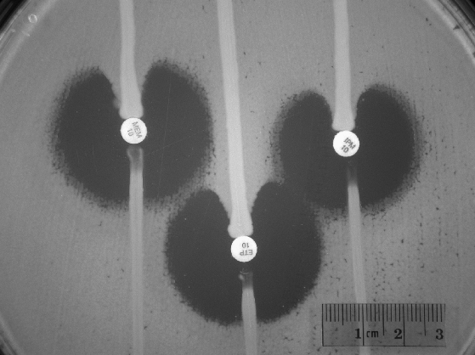
Modified Hodge Test
Pos Control
KPC +
KPC -
Neg Control
Lawn of E. coli ATCC 25922
1:10 dilution of a
0.5 McFarland suspension
Not specific for KPC
Confirm with PCR
Courtesy J. Patel, CDC

Slide 8
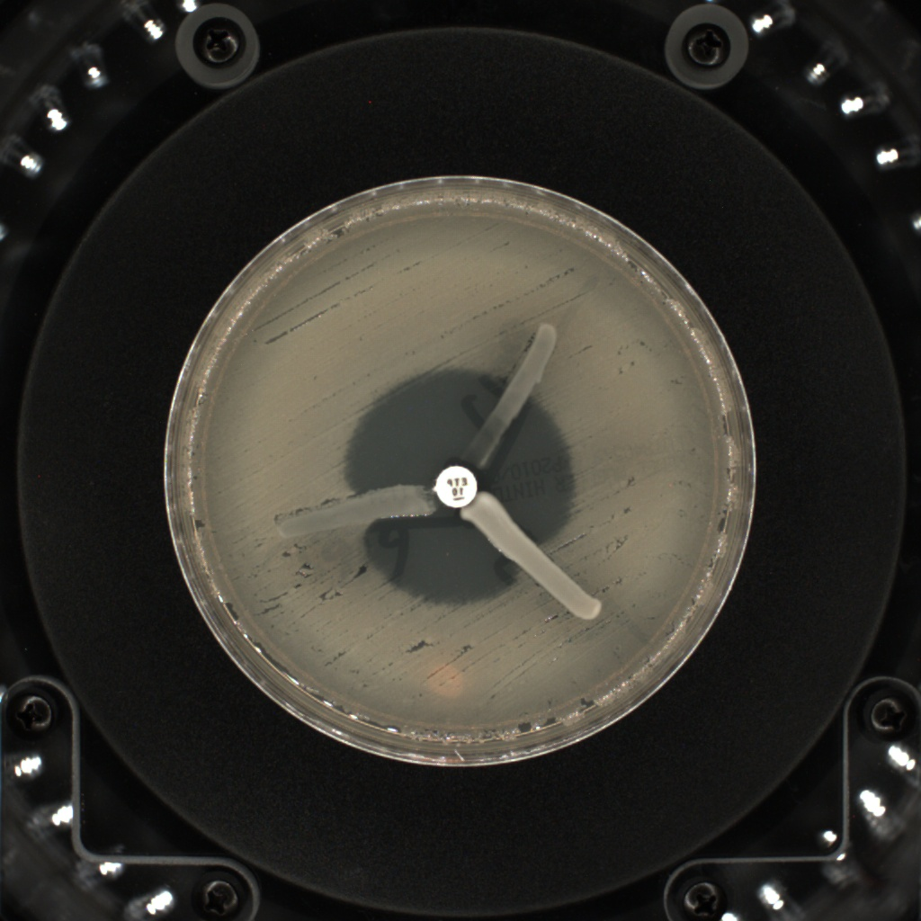
Enterobacter and MHT

Slide 9
Does Your laboratory
A. Perform the Modified Hodge Test
B. Perform KPC PCR
C. Perform both Modified Hodge and KPC PCR
D. Not perform either
E. Don’t know

Slide 10
Not all carbapenem resistance is due to KPC
KPC
Metallo β Lactamase (MBL)
Hyper AmpC with porin abnormalities
Reflux/Efflux pump mechanisms

Slide 11
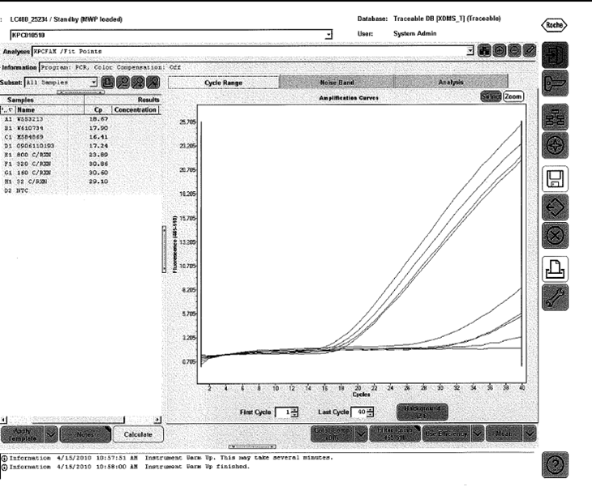
Culture Screen Method for Patients w/KPC
Rectal
Swab
5 ml TSB
Add 10 μg
Ertapenem disk
(2 μg/mL)
35°C/18 hours
PCR assay
For BLA_{KPC}
Advantages:
Rapid and sensitive
Target is the BLA_{KPC} plasmid not bacteria
Procedure from J. Patel, CDC

Slide 12

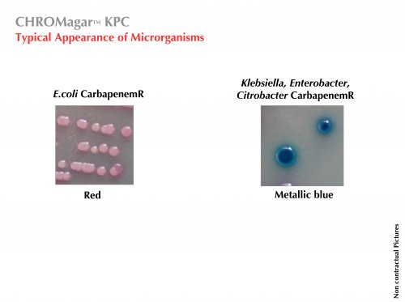
Chromagar
Not FDA Approved

Slide 13

Testing Offered at WSLH
Modified Hodge Test
KPC PCR
  Clinical labs may submit isolates for fee-exempt confirmation.

Slide 14
Laboratory Surveillance for KPC (CRE)
Enterobacteriaceae (excluding Proteus spp., Morganella spp, and Providencia spp.) that meet the following criteria:
  Ertapenem MIC 2-4 ug/ml or DD 19-21mm
  Or Meropenem 2-4 ug/ml or DD 16-21mm
  Or Imipenem 2-4 ug/ml
Submit isolate to WSLH with your AST results
WSLH will perform MHT and KPC PCR

Slide 15
Isolates submitted to WSLH Dec 2011 thru February 2012
Species | KPC Negative | KPC Positive
Klebsiella pneumoniae | 2 | 7
Escherichia coli | 6
Enterobacter cloacae |  | 1
Citrobacter freundii | 1

Slide 16
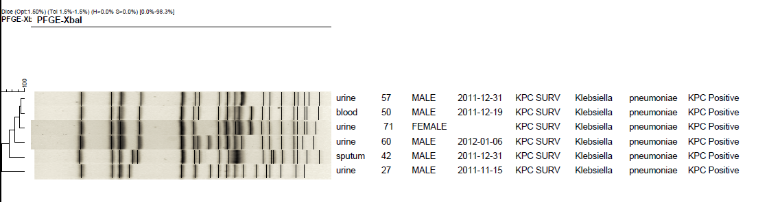
K. Pneumoniae KPC Cluster
PFGE Subtyping

Slide 17
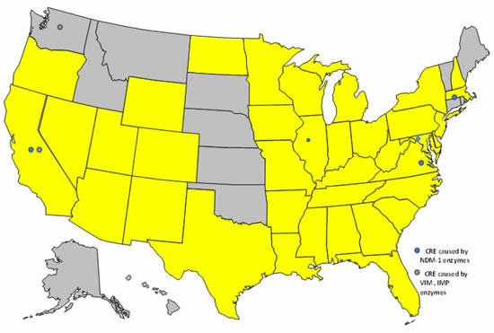
U.S. Reported KPC- 2011
http://www.cdc.gov/HAI/organisms/cre.html

Slide 18

Thanks to all the labs who have submitted isolates!
Please continue to submit CRE’s in the future

